Slide 1

ROYAL A
By Holloways, For Holloways

Slide 2
THE TEAM
Kiat Han Kok Bartal Veyhe
Dan Coles Joao Mota
Shao Feng Liu Ji Ha Kim
Hsin Je Chen

Slide 3
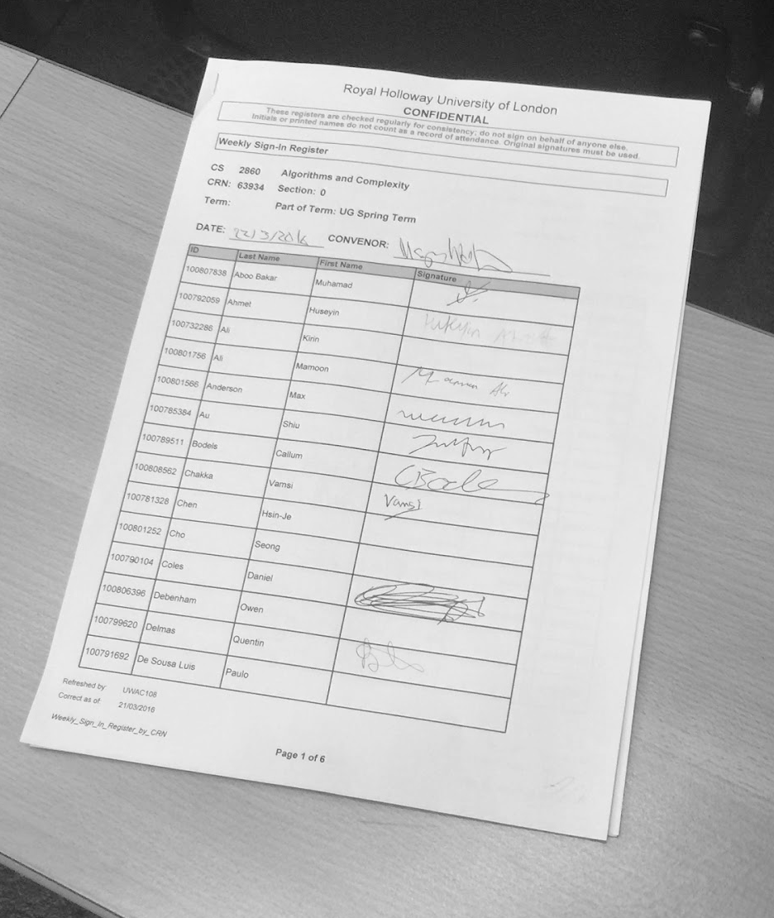
WHY?

Slide 4
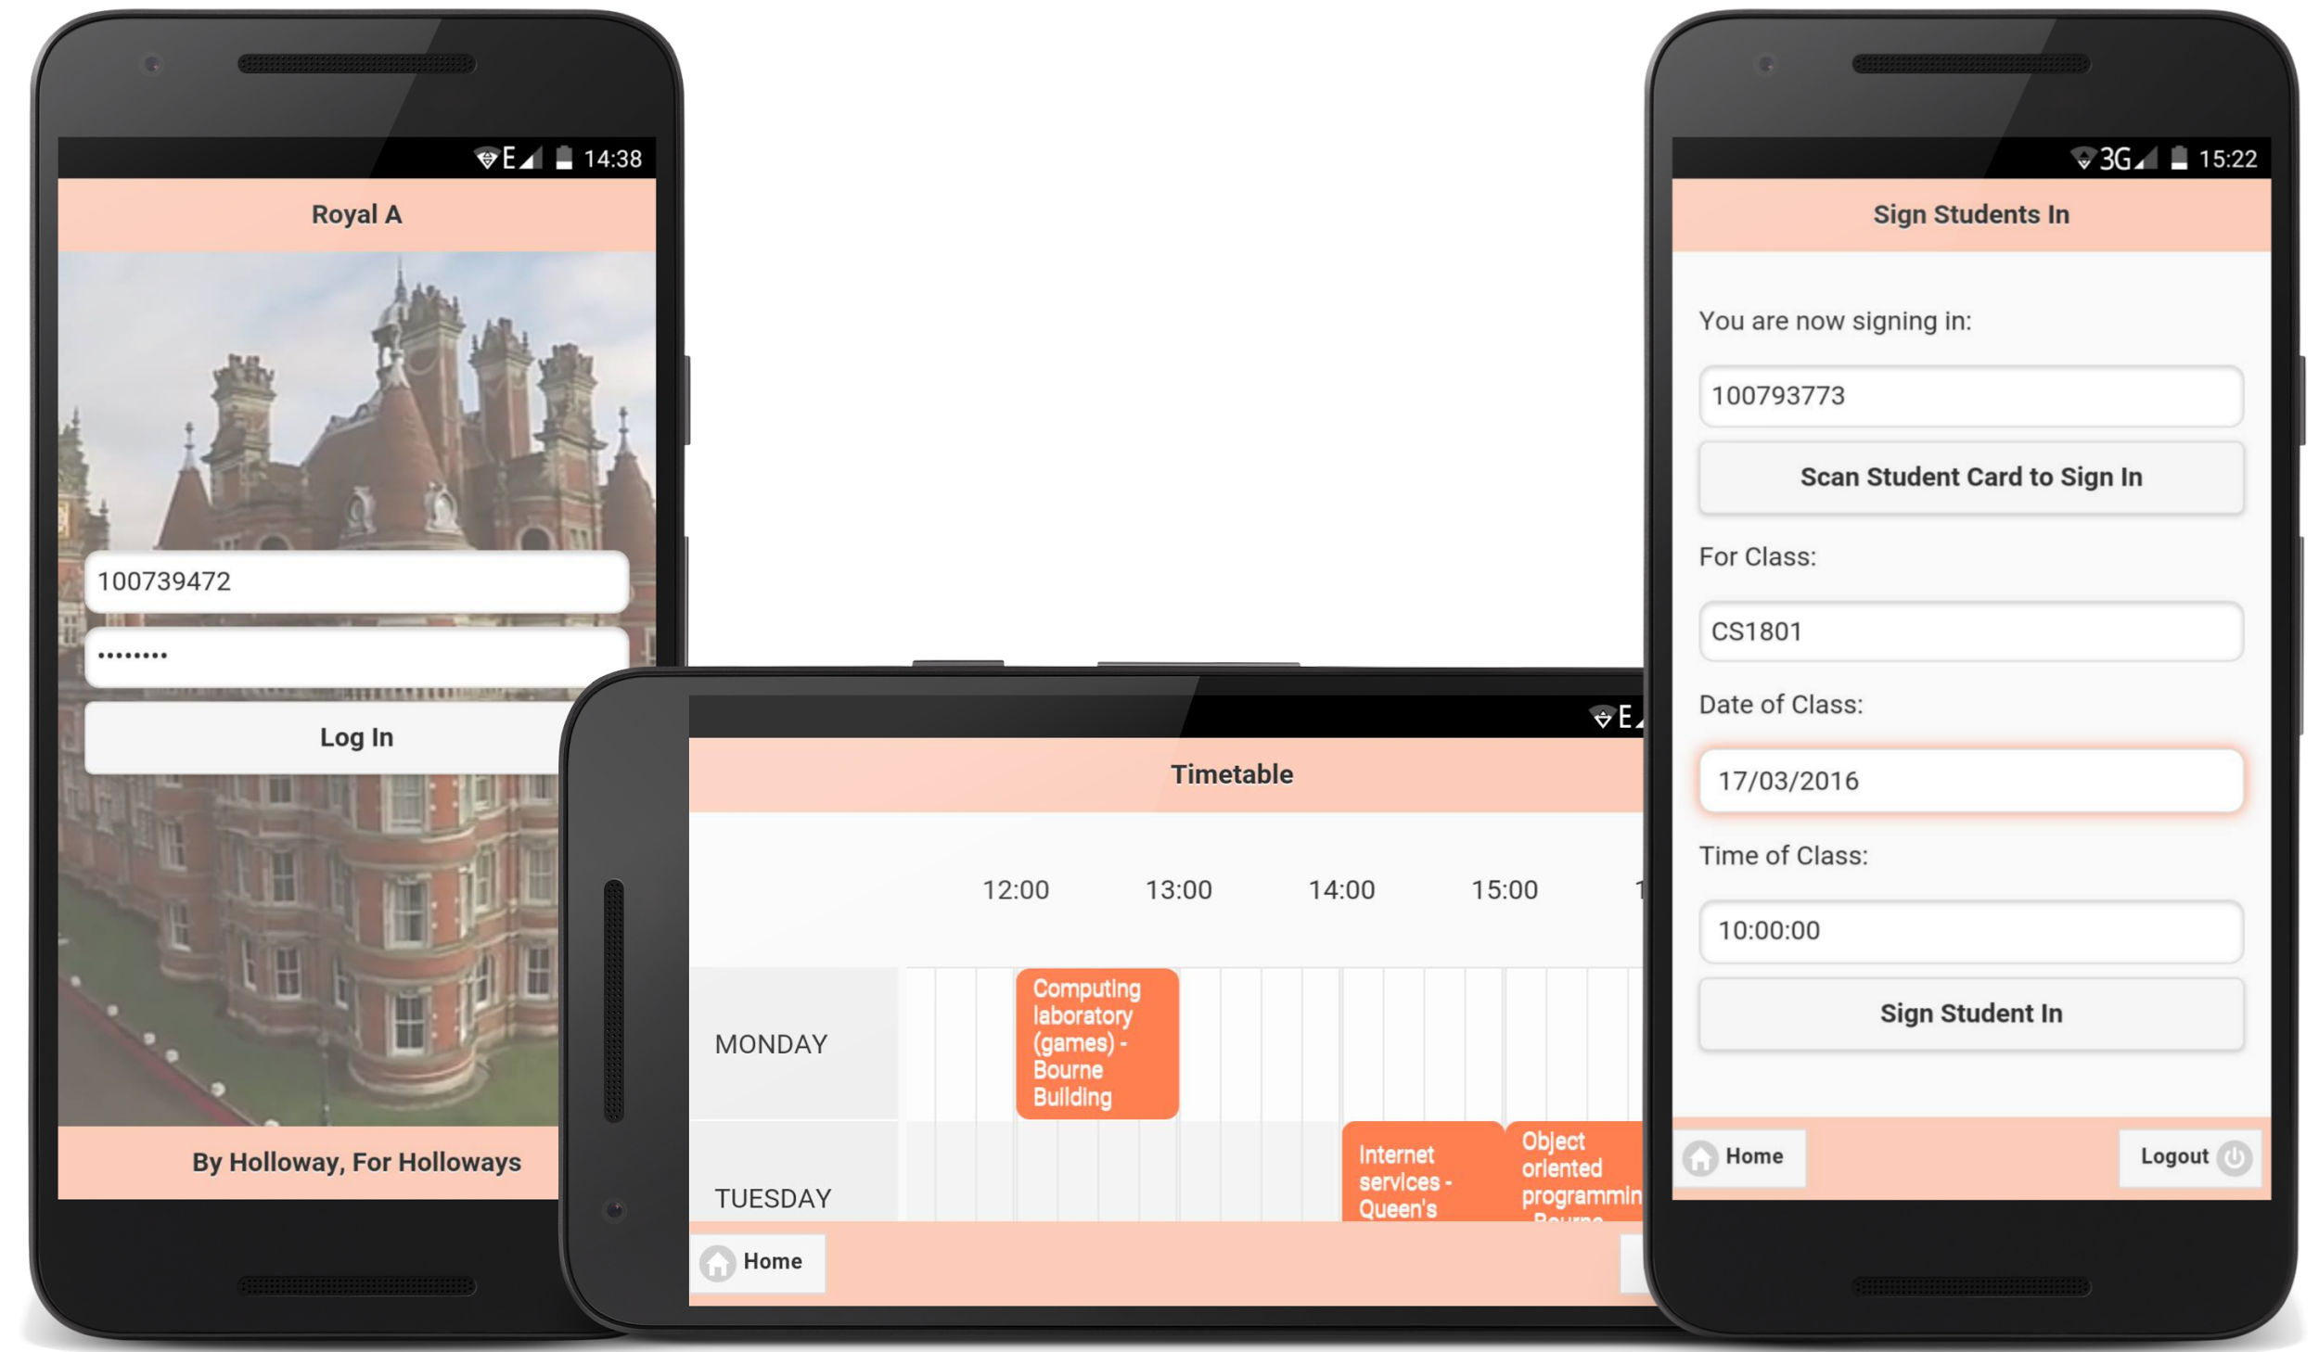
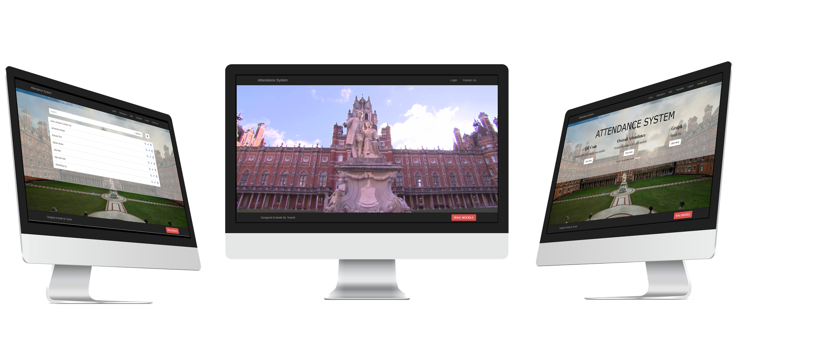
Royal.A.

Slide 5
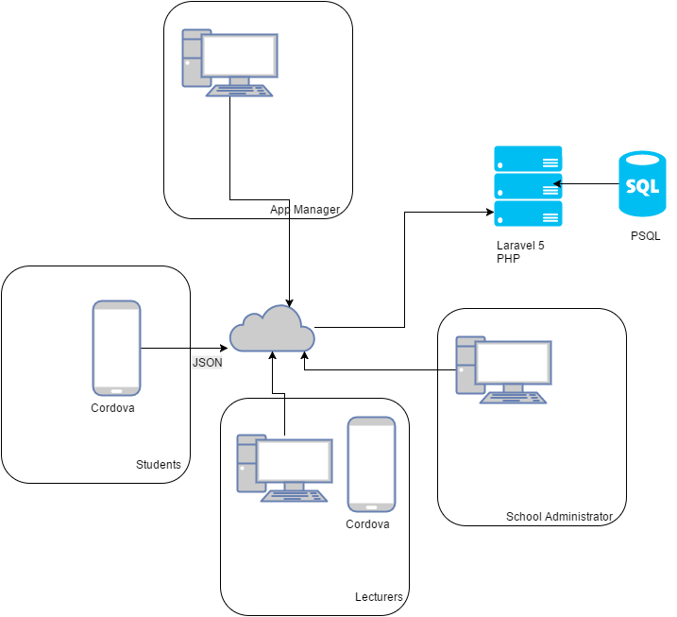
BLUEPRINTS

Slide 6
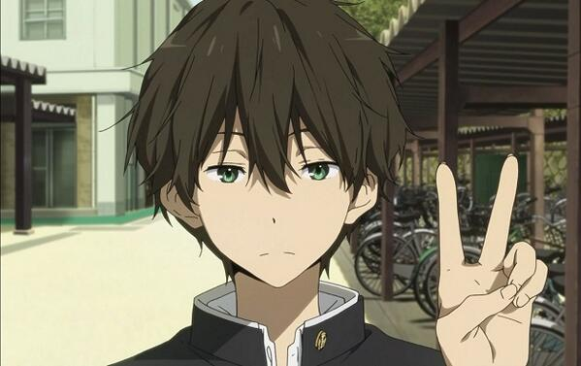
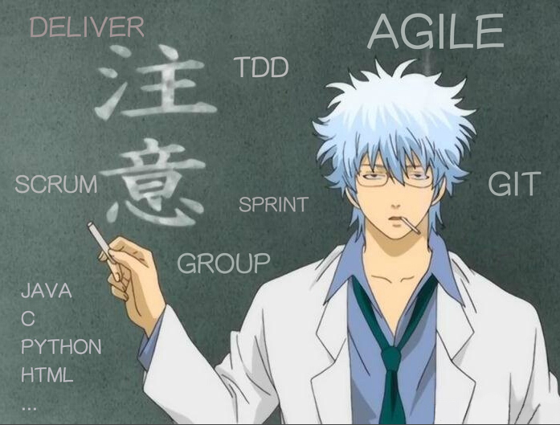

WHO?
Student Lecturer Administrator

Slide 7
Sign In & Attendance Tracking
Royal.A.

Slide 8
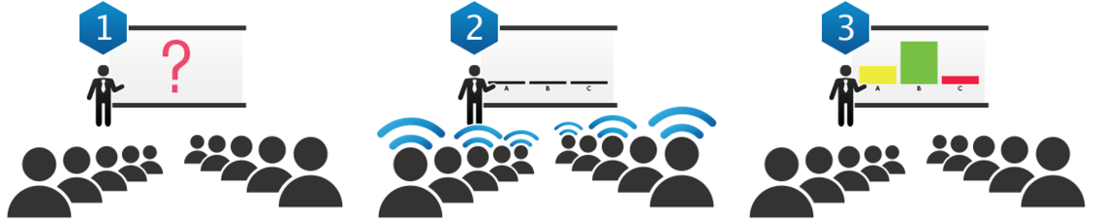
Questions & Answer (clicker)
Royal.A.

Slide 9
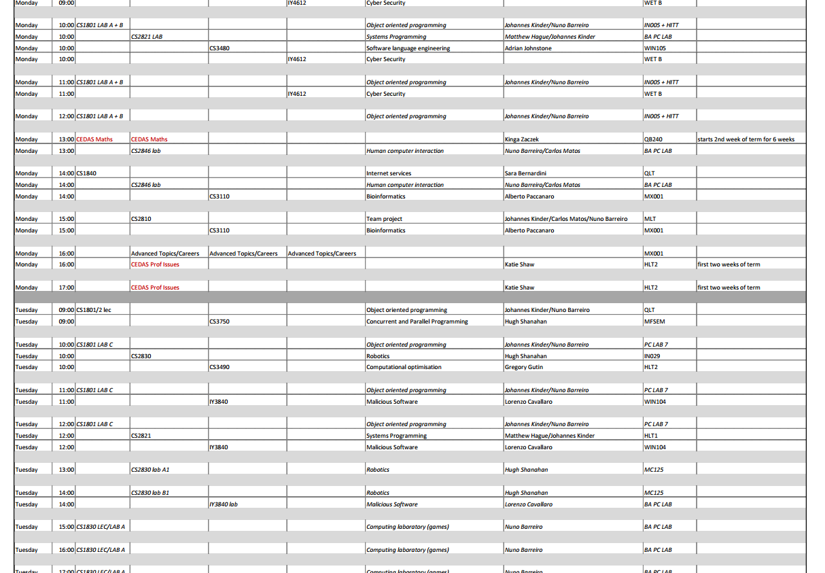
Timetable
Royal.A.

Slide 10
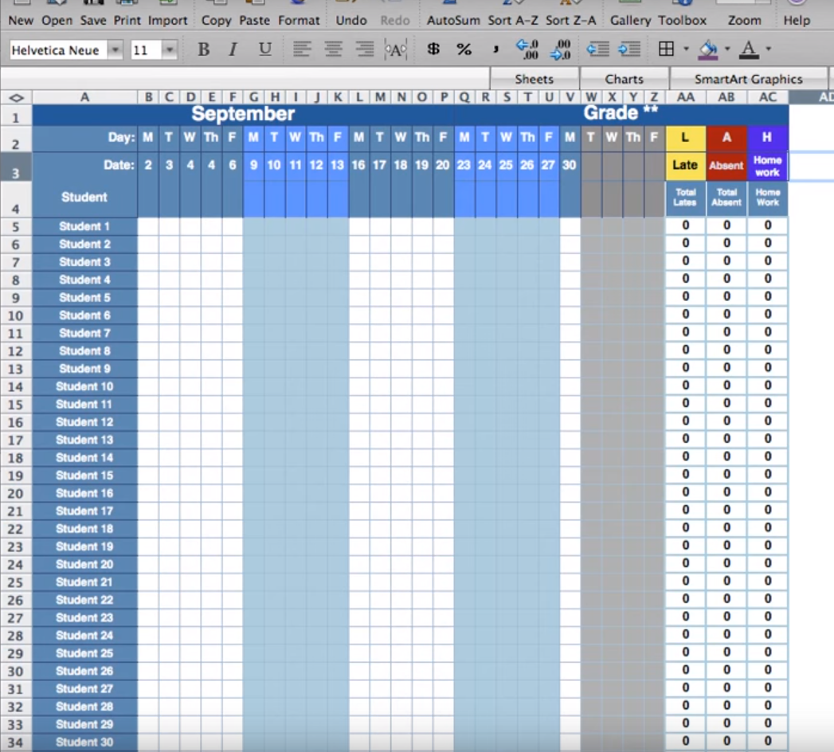
Analysis and Review
Royal.A.

Slide 11
what we LEARNT
SCRUM & Communication
Adapt to and learn new development environments + frameworks + languages
Time & Task Management

Slide 12
Questions?

Slide 13
User Stories
 | Lecturer | Student | App Manager | Admin
Things I want to do as a: | Send QR code. Check Attendence. Add / Remove attendance of students manually. Activate / Deactivate prepared questions. Notify student there is an activate question. Check the result of Q&A. Check timetable. | Scan QR code for registration. Check timetable with the location and the time for the lecture. Answer activated questions. View own attendance through out the week. View the next lecture by checking ‘what’s next’. | Add / Remove users to the system. View detailed attendance. View absence detail. | Sign in into the system. Review individual student’s attendance.

